Slide 1
Steps of developing research questions
Brainstorm
Topic
Write down potential questions
Literature search
Hypothesis
Mind map---structure

Slide 2
Brainstorm. What have you been reading and studying? What prompted you to begin your study project? List any topics that might interest you.
Write down questions about your topic
Think about controversies or inconsistencies in what you are reading.
You may find it helpful to write some contents for raising a question or describing an issue you have identified and trying to propose an answer: this is a first step to generating a hypothesis.
As you start generating possible hypotheses, think about what further data or analysis might help to answer your question.

Slide 3
Criteria for evaluating research questions
Researchable
Feasible (timeframe, constraints)
Specific and focused
Complex enough
Relevant to study/society (not fictional question)

Slide 4
The setting of your essay
A general description of (the building, literature, etc.)
The list of measurements taken
A brief summary of the history

Slide 5
Group discussion
What is critical thinking?

Slide 6
"the art of analysing and evaluating thinking with a view to improving it" (Paul & Elder 2009)
Notes:
Critical thinking has been defined in many ways, but is essentially the process of deliberate, systematic and logical thinking on any subject, while considering bias or assumptions that may affect your discussion. Critical thinking can be defined as, "the art of analysing and evaluating thinking with a view to improving it" (Paul & Elder 2009).

Slide 7
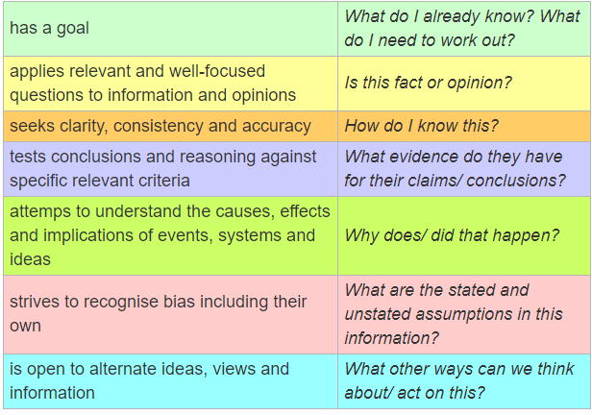

Slide 8
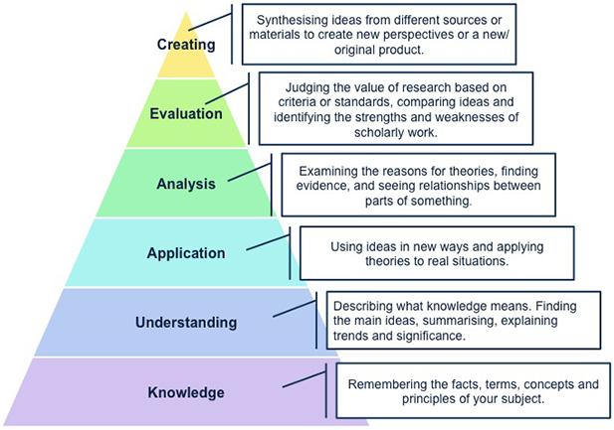
Notes:
https://bridge8.wordpress.com/2012/01/30/critical-thinking-animations/

